Slide 1
May 10 Lecture Slides
Dr. Chowdhury

Slide 2
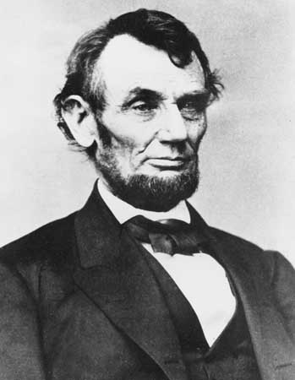
Another Great “Wall Breaker”: President Abraham Lincoln (1809-1865)

Slide 3
A Famous Quote from Lincoln
“On the side of the Union, it is a struggle for maintaining in the world, that form, and substance of government, whose leading object is, to elevate the condition of men—to lift artificial weights from all shoulders—to clear the paths of laudable pursuit for all—to afford all, an unfettered start, and a fair chance, in the race of life.”

Slide 4
The Metaphor in Lincoln’s Speech
America Dream= a foot race
Equal start but different finish
But how can slaves and poor white men and women of all classes and colors compete with rich, educated white men if they don’t get an “equal start”?

Slide 5
The American Civil War (1861-1865)
Unionists vs. Confederates
Caused by
Economic rivalry
Ideological rivalry

Slide 6
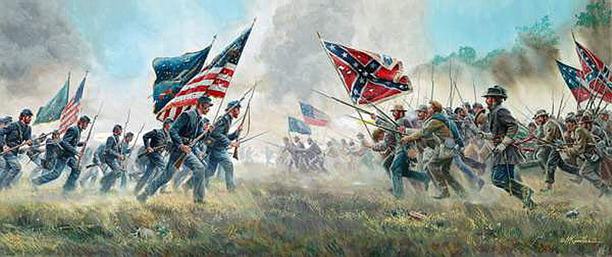
Blue vs. Gray

Slide 7
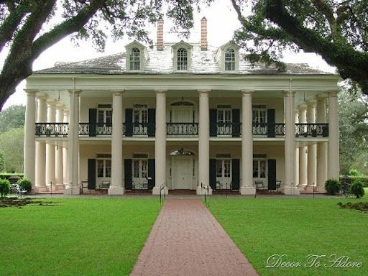
The Plantation House as Powerful Symbol

Slide 8
The Plantation House
A symbol to Southern Upper-class Whites of
Hospitality
Courtesy
Refinement
High culture
Leisurely way of life
Courage, gallantry, open-heartedness
Purity of bloodline or breeding or lineage
Pre-industrial heroic lifestyle

Slide 9
Outcome
Union won after great loss of life and infrastructure
Slavery abolished (Emancipation Proclamation 1863)
Lincoln assassinated
Blacks still discriminated against in both North and South
Free but not equal
Did not own land
Worked as share croppers, servants
Victims of lynching & mob beatings
Could not move freely
Could not vote freely

Slide 10
Outcome concluded
Traditional class hierarchy still existed in South
Large-scale landowners had too much influence
Poor, working whites mistreated
Women black or white, upper-class or lower class had no rights, economical or political
Black women victims of sexual violence

Slide 11
Opening Scene: 1st Courtroom and moving once again
How does the judge treat Abner compared to Mr. Harris? Fairly or unfairly? Why?
What do you find out about Sarty’s attitude toward his father from his thoughts and actions during the court scene?
What did Sarty’s father do during the civil war 30 years ago? How has his war-time experience shaped his present-day character?

Slide 12
Answers
Landowner gets respect but not poor white man
Judge not entirely fair—very incompetent—kind to Sarty but racist to the absent black messenger
Sarty torn between love for & duty to father and commitment to truth & justice
Horse thief, no loyalty or principles
Addicted to risk taking and adventure
Mentally lives in state of war & chaos
Trusts nobody
obeys no rules but own
Must defend personal honor at all costs

Slide 13
Topics about Symbolism
What does Abner mean when he says, “You got to learn to stick to your own blood or you ain’t going to have any blood stick to you”? What does the noun “blood” symbolize throughout the story?
What do references to “bovine” or cow-like creatures and cow-like behavior of some characters symbolize?
What is significant about the references to Abner’s wolf-like behavior?
What do horses symbolize in this story?
What about the mules?

Slide 14
Answers
Blood: Purity of bloodline or family-line, family loyalty more important than larger community, symbol of manhood
Bovine: symbol of instinctive submission, followers rather than leaders, prey rather than predator, slow, unintelligent

Slide 15
Answers
Wolf: top predator, natural leader, symbol of fierceness, independence and intelligence
Horse: courage, gaallantry, adventure, gracefulness, beauty, symbol of Southern upper-class lifestyle
Mules: barrenness, lack of change, lack of creativity, symbol of routine and uninteresting work

Slide 16
The two Houses
What is the significance of the way the house that Abner moves into with his family described by the narrator?
What are Sarty’s thoughts and feelings when he sees Colonel De Spain’s house for the first time?
What does Abner do during their first visit to the De Spain house and what does he say to Sarty after doing it?
Even though his action is inappropriate, what historical truth about such houses does he teach his son?

Slide 17
Answers
Looks the same as previous one, symbolizes dead-end and repetitious nature of Abner’s life, hopelessness
Sarty associates De Spain house with culture, security and beauty
Abner points out historical injustice and exploitation

Slide 18
Second Court Scene
Do you think the second judge is more competent and fair compared to the first one? Why or why not?

Slide 19
Answers
Certainly more fair: gives a balanced verdict
Does not favor Col. Sartoris
Treats Abner with respect

Slide 20
The Minor Characters
What do the two minor black characters reveal about Abner in particular and the Southern society in general at this time in history?
What do Sarty’s mother’s words & actions reveal about lower-class white women’s situation in this society at this time?
Do you think Colonel De Spain is a courteous southern gentleman victimized & bullied by Abner? Or do you think he is not really as nice as he seems to be?

Slide 21
Answers
Black characters
First one represents average blacks: without property without rights, being abused & exploited by everybody including Abner
servant represents free blacks “protected” by upper-class white men, just like upper-class white women protected as daughters and wives and mothers, ex: Mrs. De Spain

Slide 22
Answers
Sarty’s mother:
Wants a stable life but can’t have one
Wants Sarty to be different from father
Wants Husband to stop violence
Wants Abner to feel like a man, be respected
Wants to save both husband and son
Put to an unfair and cruel test by Abner
Lacks security & protection unlike Mrs. De Spain

Slide 23
Abner
Why does narrator say that Abner’s actions and words lack “heat”?
Why is Abner described as a flat figure cut from tin?
Why does narrator say that the old coat he wears is green like “the bodies of old house flies”?
Even though Abner is a small and skinny man why does the narrator say that his footsteps sound so heavy when he walks up to De Spain’s house and his small body is “not dwarfed by the white door”?

Slide 24
Answers
Lack of heat: Lost all hope and joy in living
Flat figure: flattened by years of exploitation and oppre ssion
Green like flies: disgusting, associated with death and decay, opposite of wolf-image
Heavy footsteps and dwarf image: attempt to maintain dignity, challenge traditional authority

Slide 25
About Sarty
Why is Sarty so upset that his father has not sent a black man to warn the land owner?

Slide 26
Answer
Turning point
Father no longer a hero who fights fair
Doesn’t understand father’s reasoning
De Spain really big landlord compared to Mr. Harris

Slide 27
Ending of Story
Do you think Sarty knew or expected Col. De Spain to shoot and kill his father?
What do you think will happen to De Spain for killing Abner? Will it be fair or not?
Why does Sarty run to the forest instead of going back to his family?
What do you think might happen to the rest of the family after Abner’s death?
Do you find the story’s ending satisfactory? Why or why not?

Slide 28
Answers
Probably not. Expected Colonel De Spain to be “nice” and “fair.”
Will claim was defending property. No consequence. Property rights vs. human rights.
Too confused. Needs to clear his head. Afraid and ashamed to face family, especially mother. Does probably return and take care of them. Flash forwards suggest he grows up to be good and just man.

Slide 29
Last One
Why does Abner tell his wife to hold Sarty instead of tying him up with a piece of rope as Sarty’s older brother suggests?
Loves taking risk
Puts both son and wife to a test of loyalty
Probably wants to die and end a painful existence and set rest of family free
Wants Sarty to be “final messenger”

Slide 30
Homework # 2 Due May 15 Read the two articles about self-made men and answer the following questions (total 250-300 words, typed, printed out, double spaced )
When some rich people claim to be “self-made” what truths do they try to hide, according to Maia Szalavitz, the author of “What's behind rich people pretending to be self-made”?
What did you learn about Mark Zuckerberg, the self-made American hero, from the article entitled “The third era of Zuck': how the CEO went from hero to humiliation” by Julia Carrie Wong?

